Slide 1
JADEC AHU Lab Overview
Upgrade Kick-off meeting 9/16/24

Slide 2
AHU Lab – Current State
3 separate DAQ systems being used in the AHU Lab
Original LabVIEW Air Flow system from Portland >> Grantley >> JADEC
Minor changes and updates were made to DAQ as requested when team moved from Portland to Grantley. New Code testers were built as part of the move.
Decision was made by team that no changes would be made when we moved to JADEC. Was one of the “lift & shift” labs
Essentially, same system for 20+ years
Until recently the system was meeting the needs of the AHU team
Trident Acoustic
Stand-Alone LabVIEW software package provided by VI acoustics
In use since Grantley (not sure about Portland)
In use on Gas Blocks – fully integrated with SCADA system
LabVIEW DAQ
Added to AHU Lab as a method to quickly acquire the additional channels required for CRAH
Same system that was in use at Grantley as the main DAQ system
Same system currently in use at MTY, SAT, and a couple of labs at JADEC

Slide 3
AHU Lab – Current State
Challenges with existing system(s)
Obsolete DAQ hardware – (Compact Field Point - cFP) limited channel count with no expansion
Stand-Alone sound measurement (Trident)
Stand-Alone system added when additional channels were needed for CRAH and now YDAM
The 3 systems are not integrated
Data Storage & retrieval – not consistent with other labs at JADEC, difficult to mesh data from 3 separate systems and minimal tools for analysis
Can only run one system (30K or 100K) at a time
Shared resources between systems (power analyzer, Dynos, temp/RH sensors, PC & DAQ program)
Recent turnover and lack of dedicated resources from test lab (Test Engineering & DAQ team)
Lack of defined requirements required for upgrade
The list goes on….

Slide 4
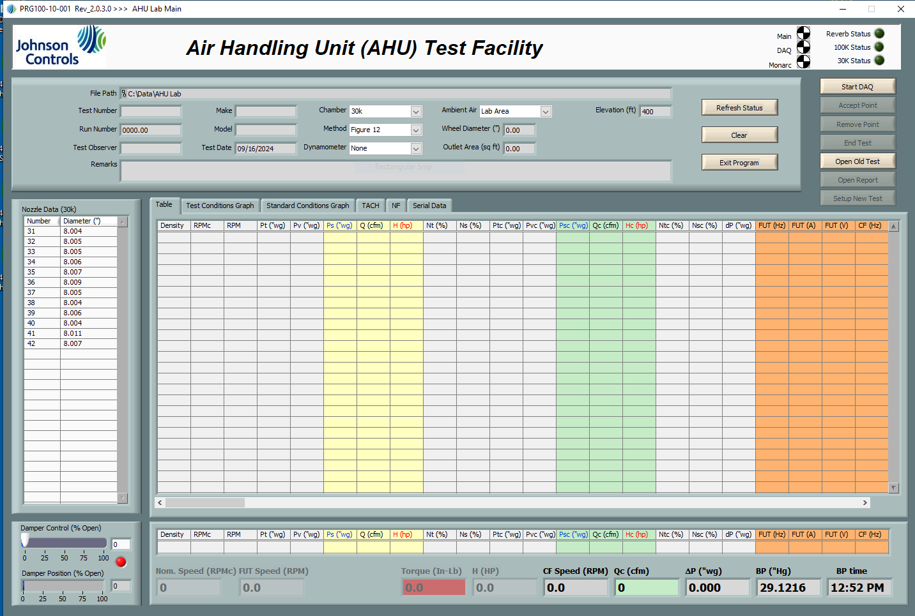
AHU Lab – Current State – Main AHU system

Slide 5
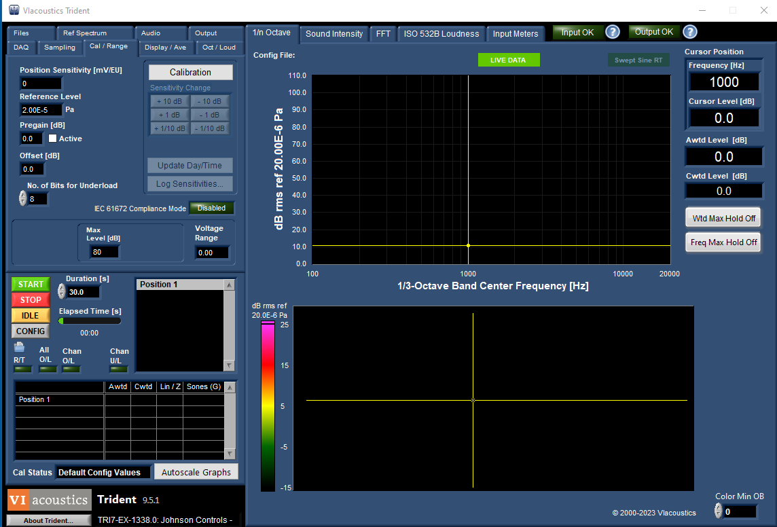
AHU Lab – Current State – Trident System

Slide 6
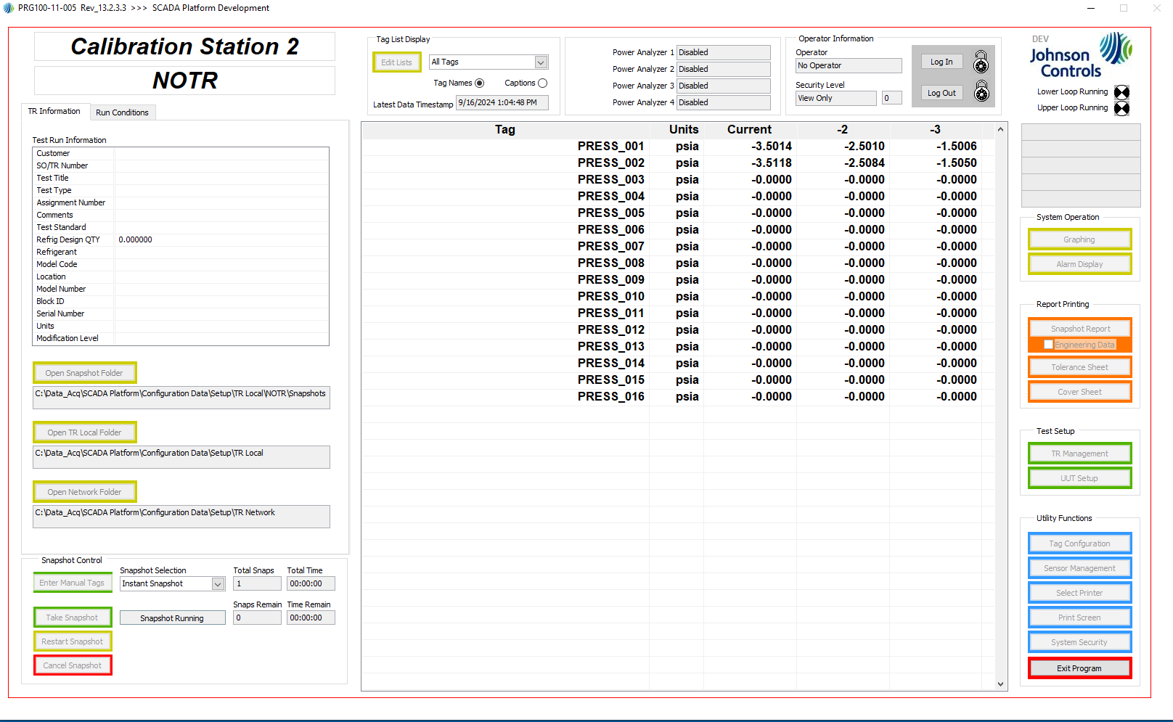
AHU Lab – Current State – LabVIEW DAQ System

Slide 7
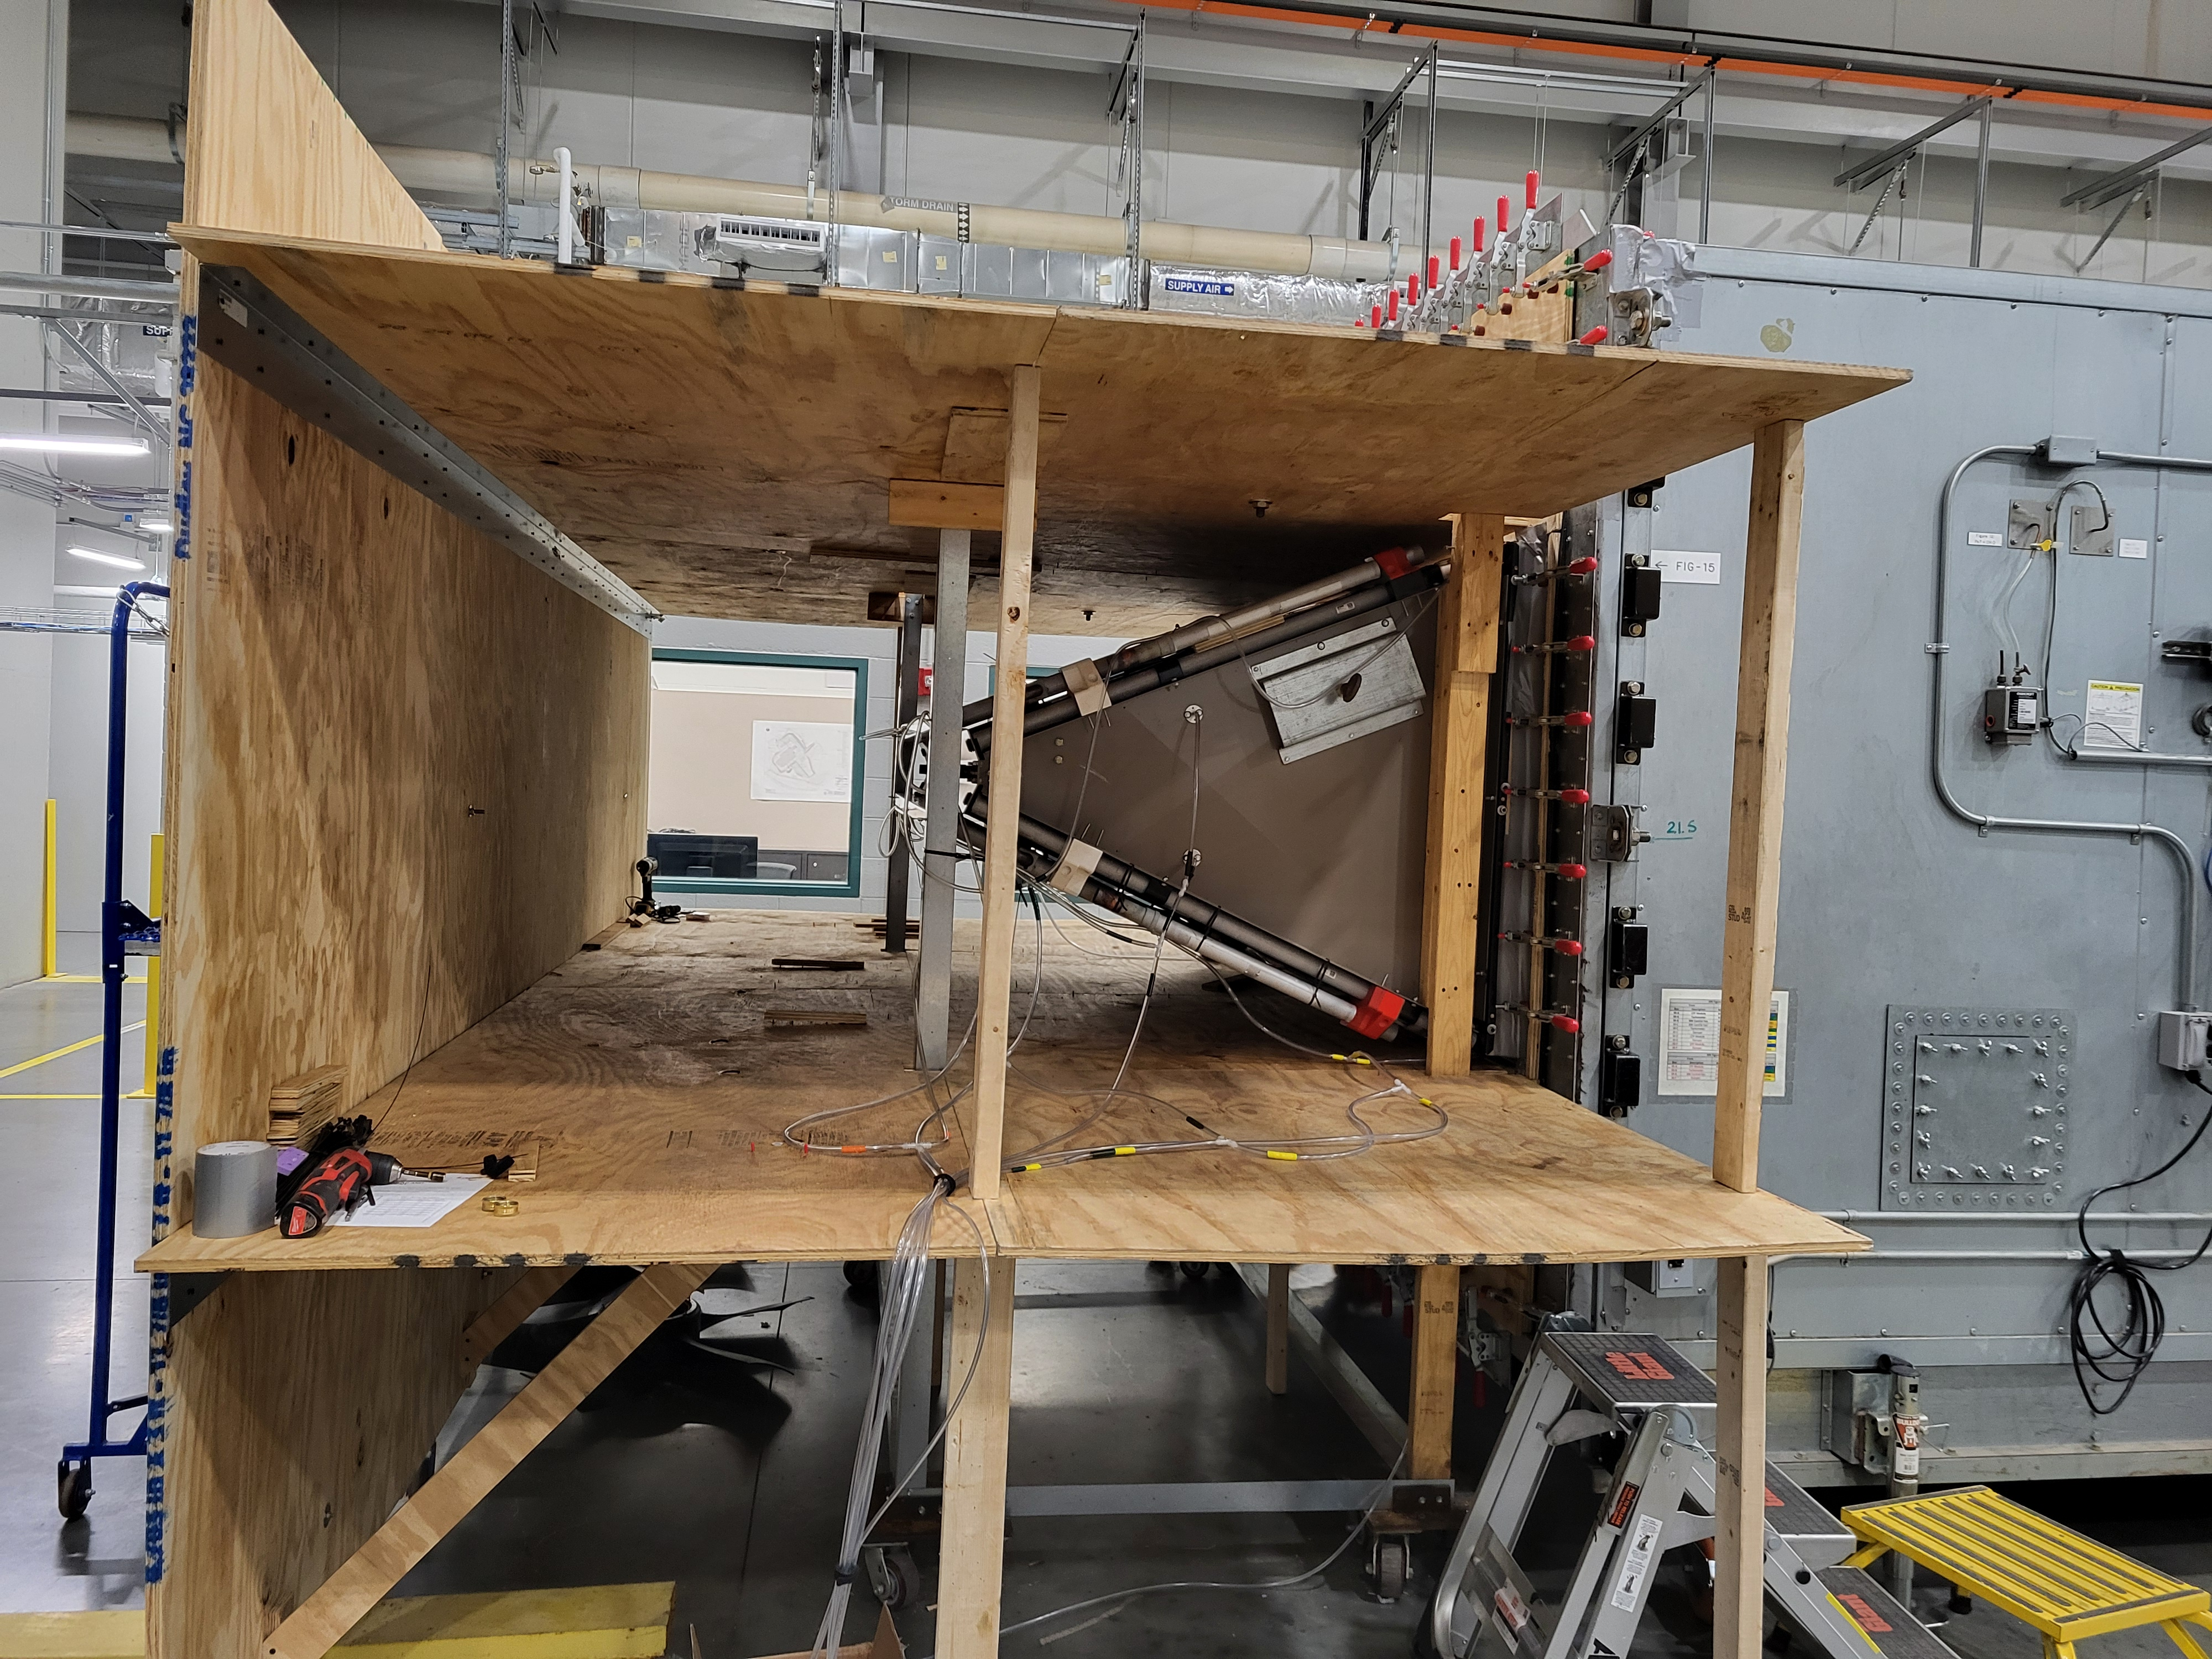
AHU Lab – Current State – YDAM
Requires
Code Tester
30K only? Yes
AHU DAQ
-Standard measurements? Yes
LabVIEW DAQ
what specifically? Airflow calculations – same as AHU DAQ. A few additional Temperatures, Pressures, and Flow
Trident no
Boiler – yes
Any other configurations? Yes TBD
Future Needs? yes. Ongoing R&D. 2 water loops, new cond coils, new fans, Blow thru vs. draw thru (Fig 12 vs. 15)

Slide 8
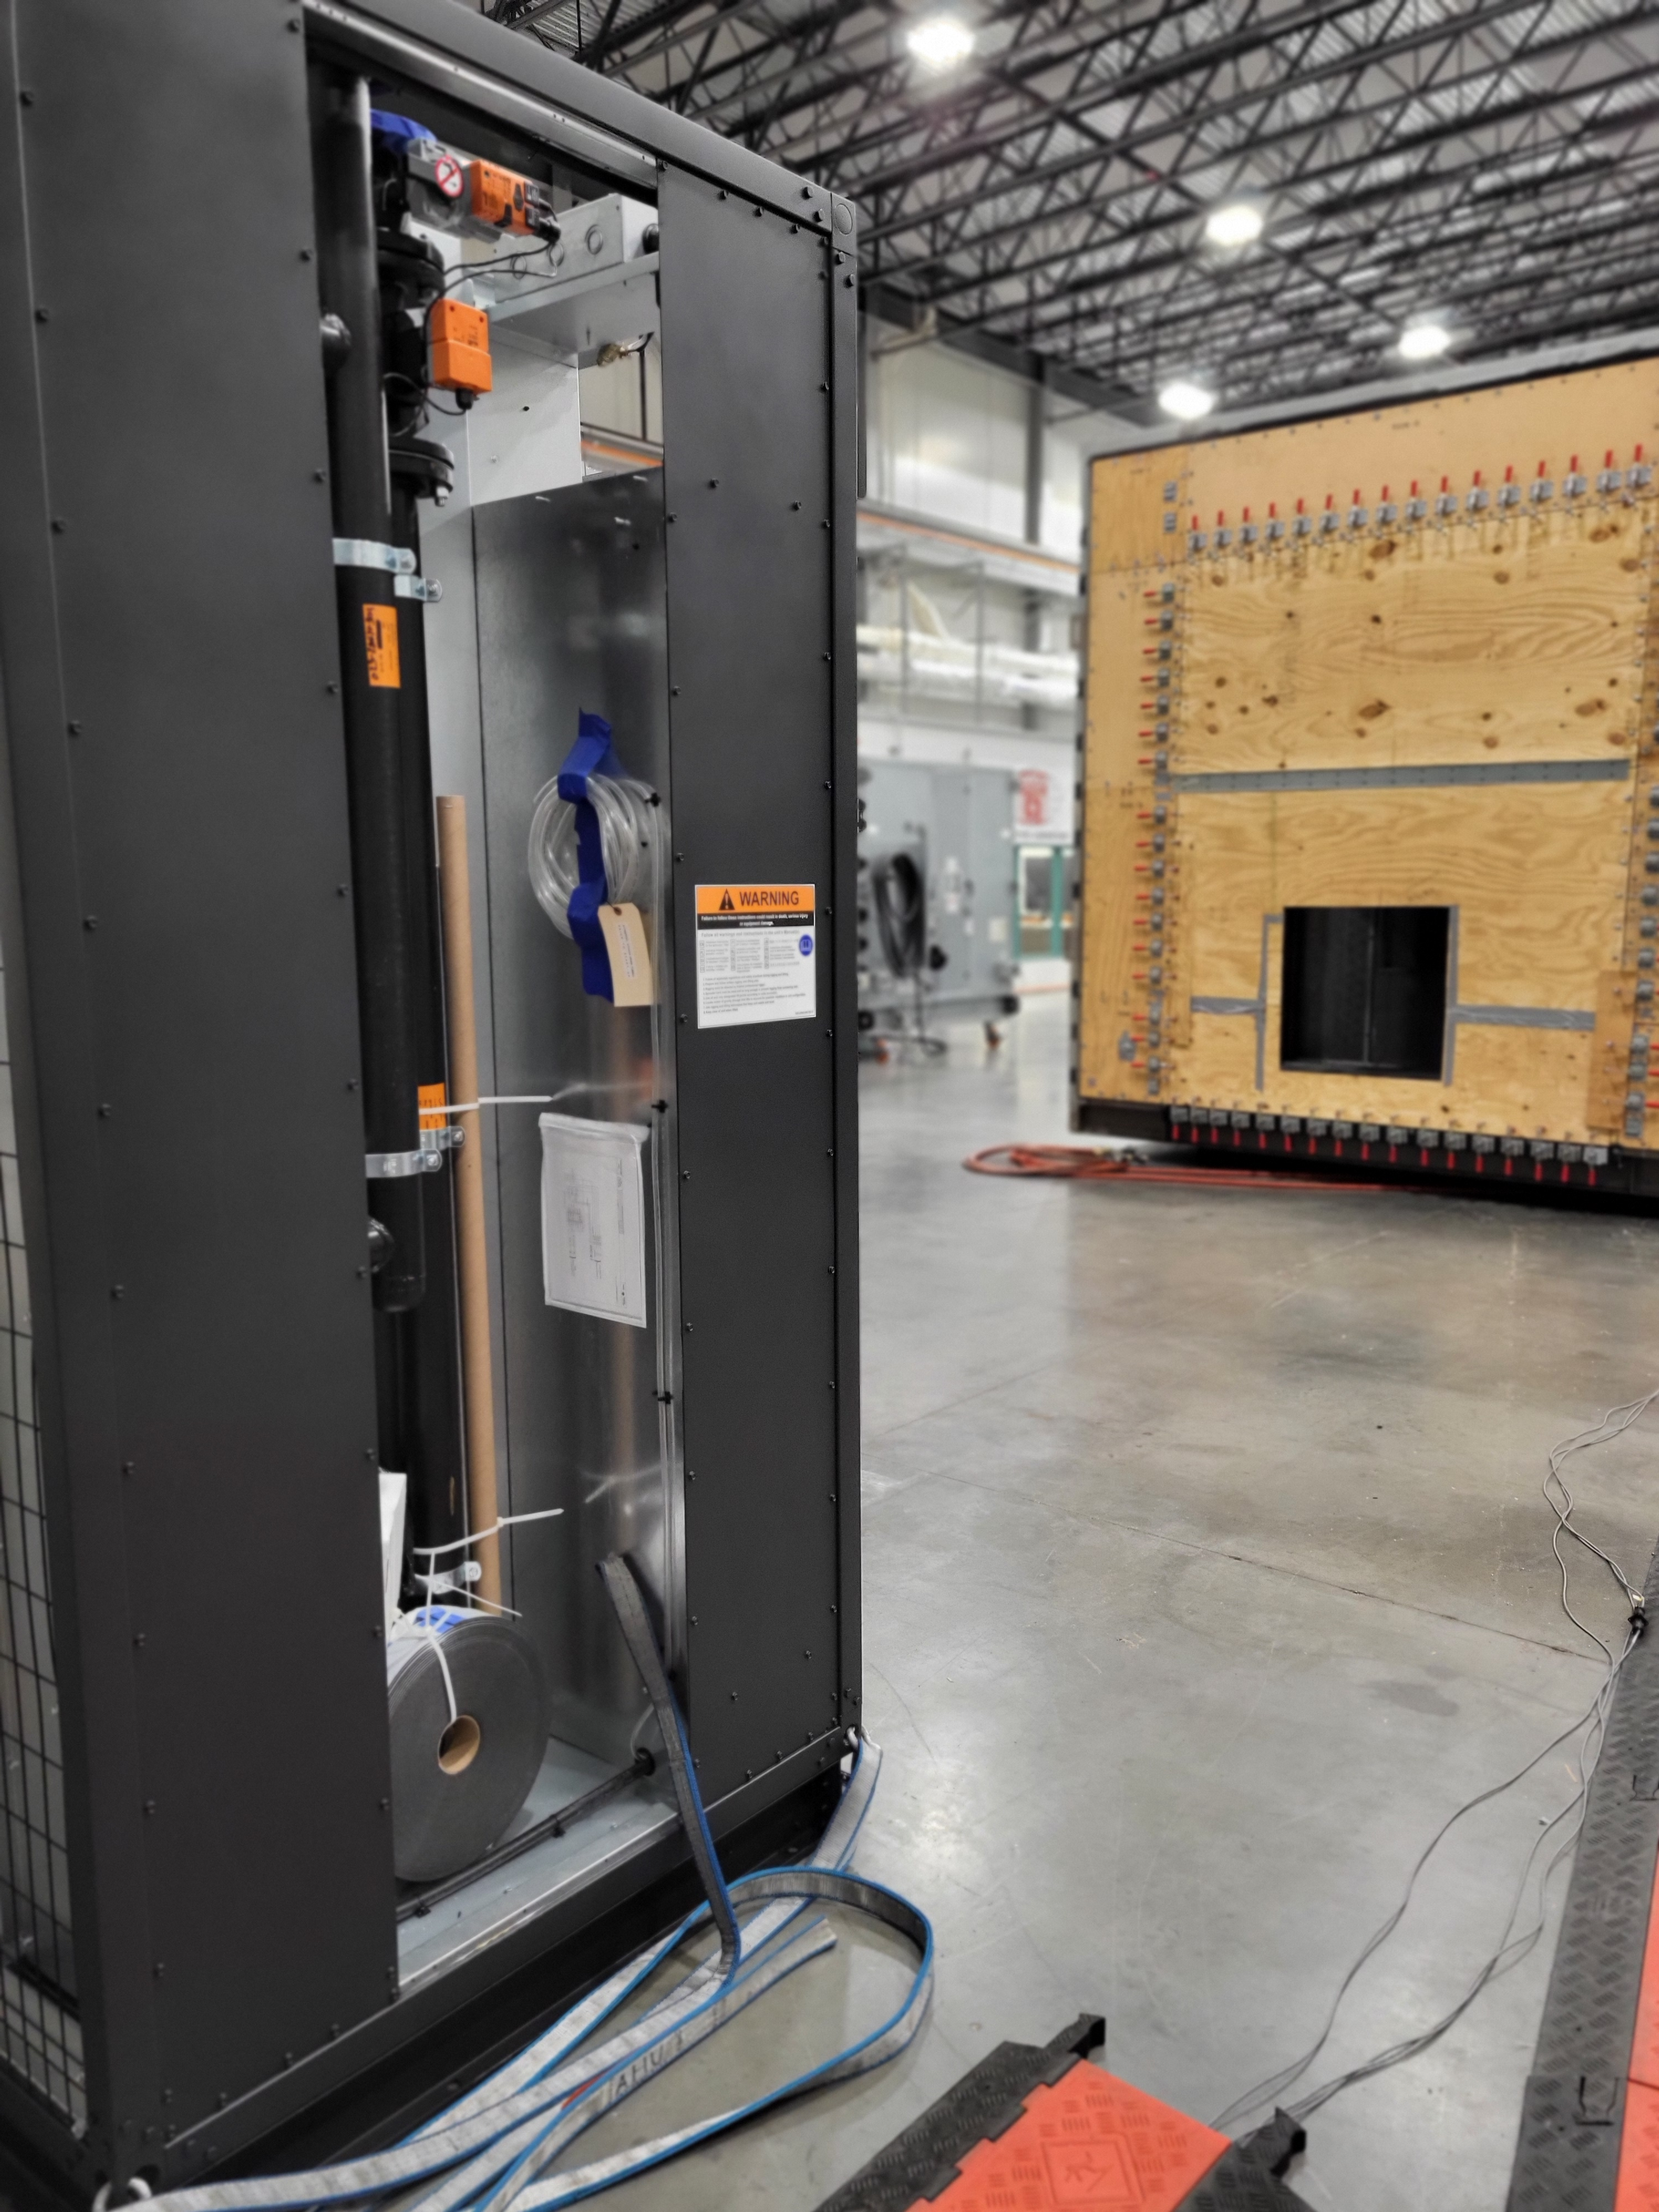
AHU Lab – Current State – CRAH
Requires
Code Tester
-100K only? Yes, for now.
AHU DAQ
-Standard measurements? Yes
LabVIEW DAQ? Yes
what specifically? Need channel counts for each measurement type
Trident? Yes
Boiler? Yes
Any other configurations? TBD
Future Needs? TBD

Slide 9
AHU Lab – Future State
Understand Requirements and Expectations of various teams
Develop short-term and Long(er)-term upgrade plans
Short Term ideas/thoughts
Replace obsolete cFP hardware with cDAQ hardware. This will allow for expansion of channel counts and eliminate some of the shared resource constraints.
Spin up 2nd stand-alone AHU system. Full system needed? (specific to YDAM, CRAH, 30k, 100k, etc..)
Need additional Dynos?, power analyzers, etc?
Medium / Long(er) Term
Integrate Trident into AHU
Convert over to TrendSafe system used on all WC, AC, and GB facilities? YES Desired
Any unique needs that need to stay with AHU? (reporting, Graphs as points are acquired, etc)
What are the required channel counts?
Automatic control wanted/needed? (Add control loops for Fan speed, damper position, etc…)
Operator feedback

Slide 10
Thank you

